Slide 1
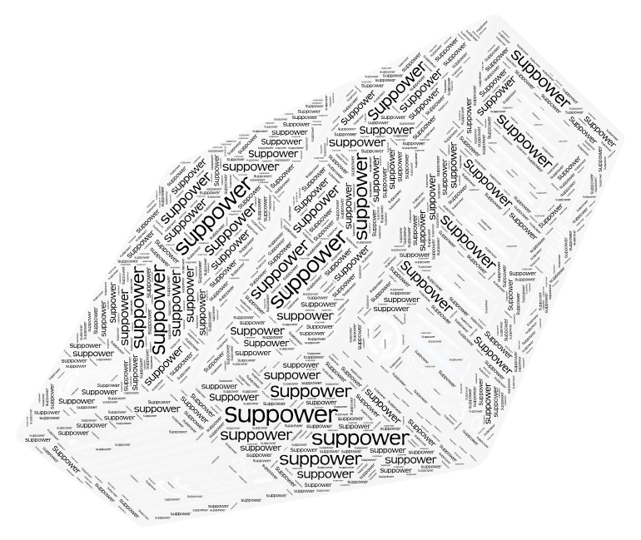
2021
SUPPOWER TECH. CO.,LTD.
Power Adapter
WWW.SUPPOWER.COM E-MAIL: market@suppower.com

Slide 2
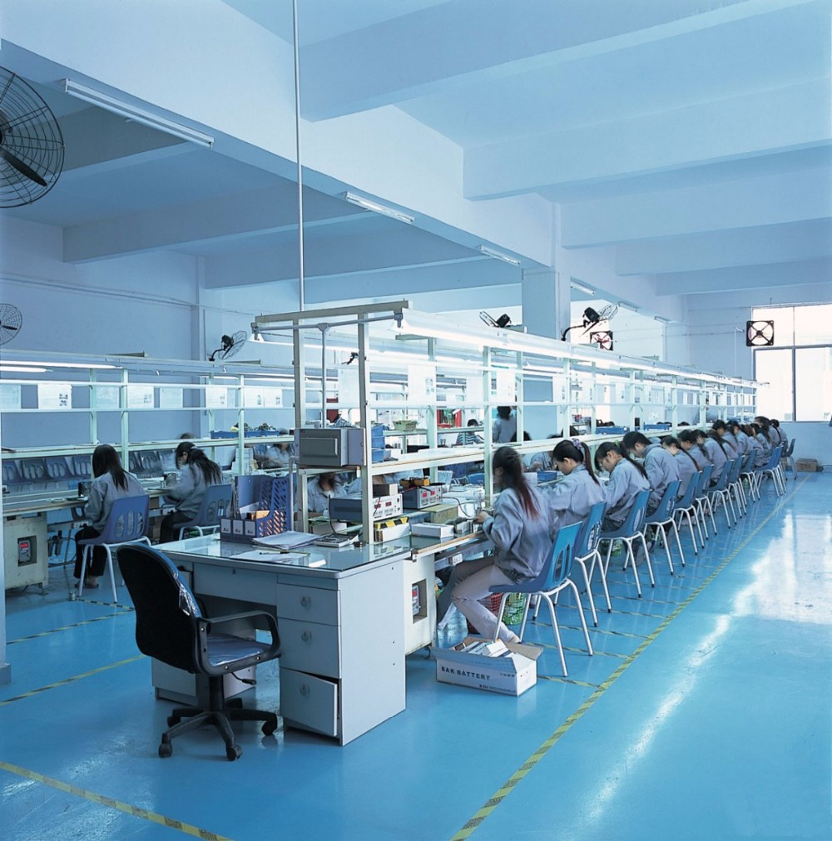

Shenzhen SUPPOWER TECH. CO., LTD.
Technology that evry can enjoy
To Shenzhen Suppower Tech. Co, Ltd. is a professional High-tech equipment manufacturers,focus on power adaptor, smart charger, battery charger etc, standard power adaptor and customized power adaptor(ODM) development, manufacture and sale.
Establish on 2002 and over 20 years work on power supply products. Our workshop scale reach 6000 sqm and we have almost 1000 skilled workers and 50 experienced management and technical personnel.All of us will keep develop and promot to makepower products still meets the needs from our customers.
Suppower would like to create win-win value together with customers by high quality, competitive price, quick response lead-time and support. “SPAYPS”is our brand- SupPower As Your Power Solution Supplier always!

Slide 3



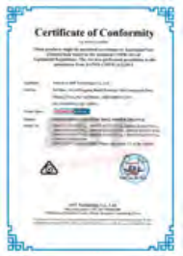
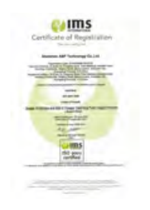
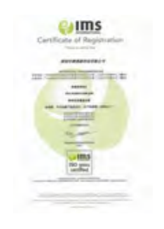


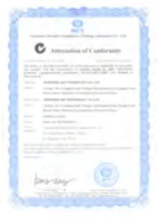

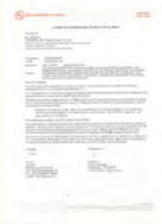
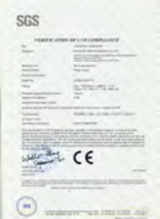
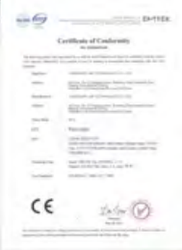
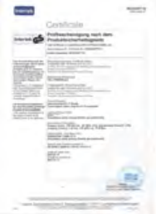
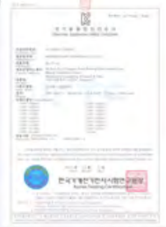
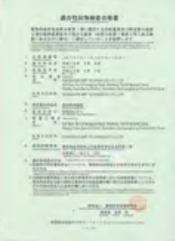
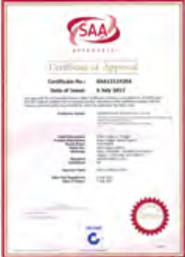
Enterprise Honor

Slide 4
01
Power Adapter
AC/DC Power Adater- EN62368,EN61347,EN61558,EN60601

Slide 5
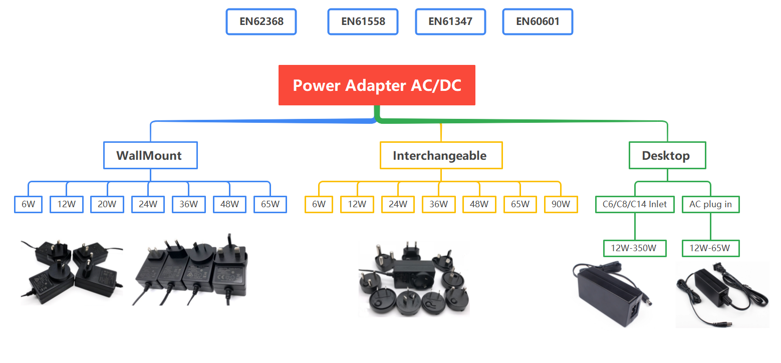

Slide 6
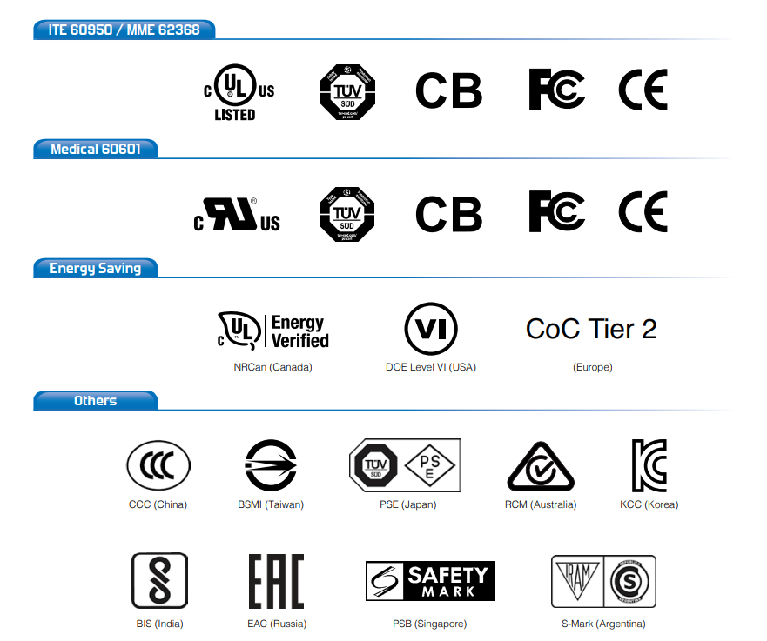
Certifications
10. 1C1A-PQ656x/65W
11. 2C1A -PQ655x/65W
12. 2C1A-PQ1005x/100W
13. 2C1A -PQ1401/140W
14. 3C1A -PQ657x/65W
15. 3C1A -PQ1002x/100W
16. 3C1A-PQ1004x/100W
17. 4C2A PQ1006D/100W
18. 1DC -A2401D/240W/
19. 3C1D-PT2401D/2402
EN62368 /61347/61558/60601
UL/CUL/FCC
CE/GS/CB
CCC/PSE/SAA/KCC

Slide 7
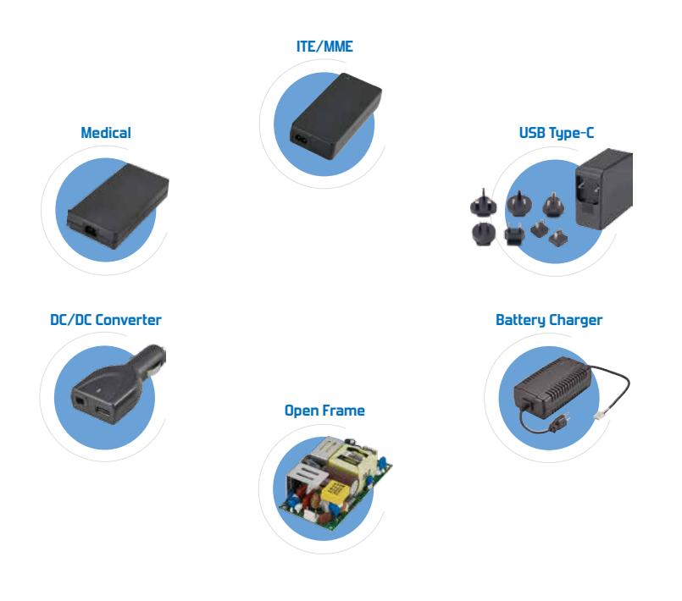
Product Series
10. 1C1A-PQ656x/65W
11. 2C1A -PQ655x/65W
12. 2C1A-PQ1005x/100W
13. 2C1A -PQ1401/140W
14. 3C1A -PQ657x/65W
15. 3C1A -PQ1002x/100W
16. 3C1A-PQ1004x/100W
17. 4C2A PQ1006D/100W
18. 1DC -A2401D/240W/
19. 3C1D-PT2401D/2402
Wallmount Type
Interchangeable
Desktop
Open Frame
QC /PD charger
Liner Power
DC converter
OEM/ODM for customers

Slide 8

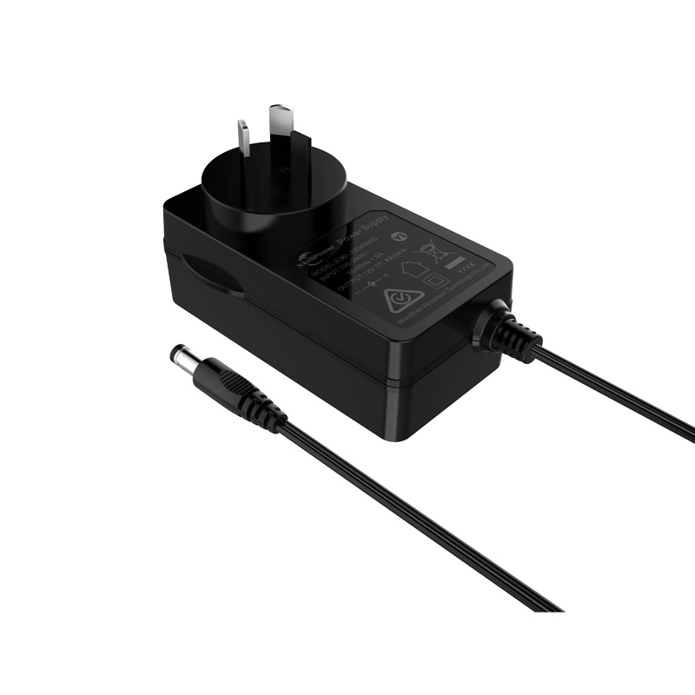
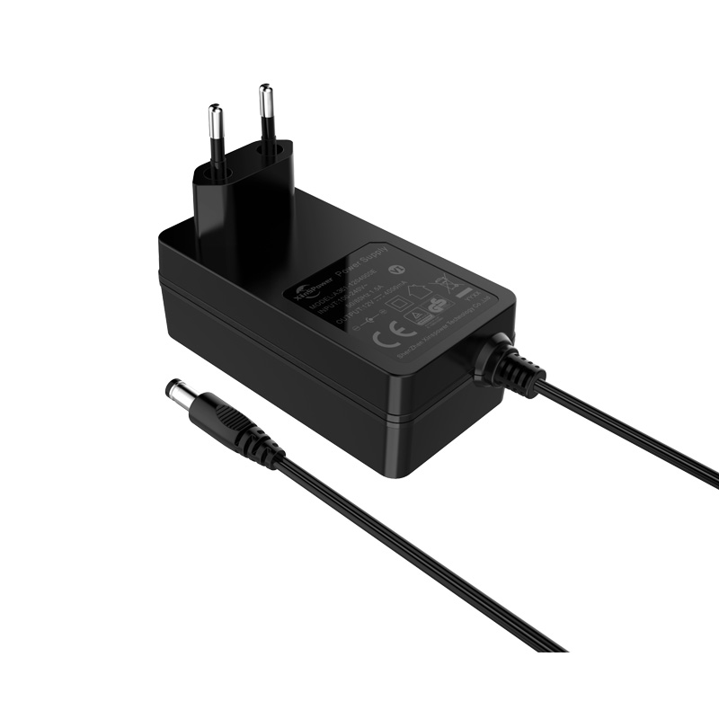
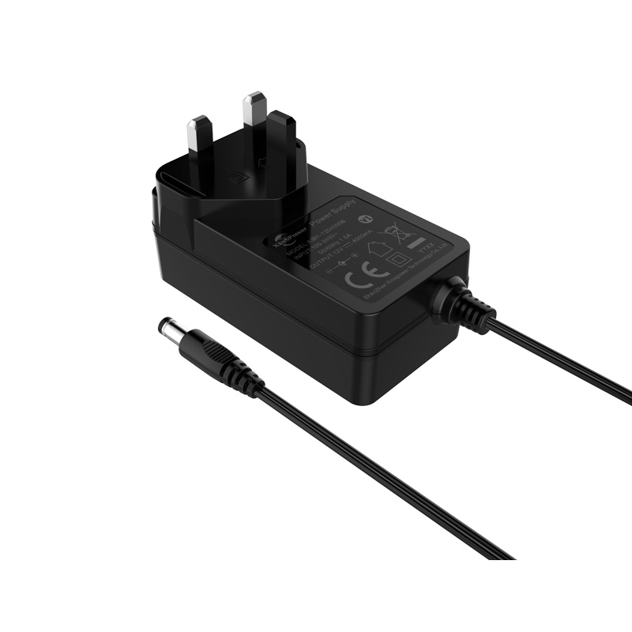
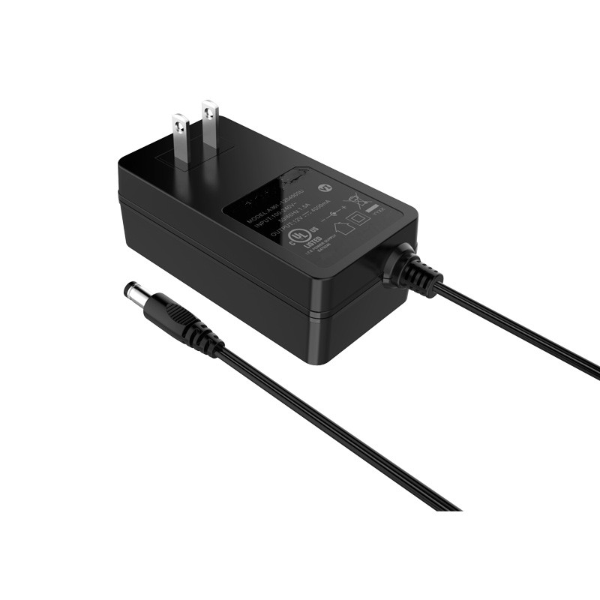
Wall mount Type
Cable Type US/EU/UK/AU/JP Plug
Input: 100-240VAC, 50/60HZ
Output: 5-36VDC
Current: 100-6000mA
Power: 3-48W
Color: White, Black or OEM
Certificate: IEC62368/61558
61347/60601

Slide 9
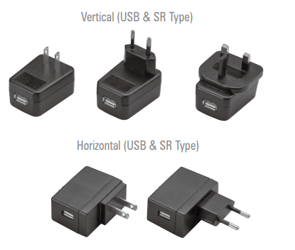
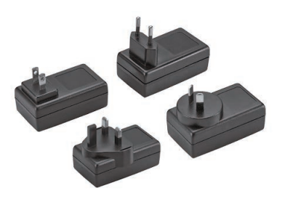
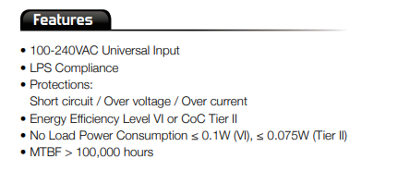
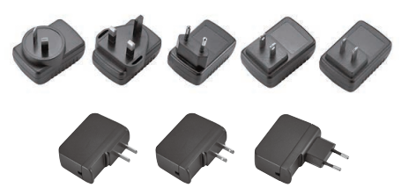
Wall mount Type

Slide 10
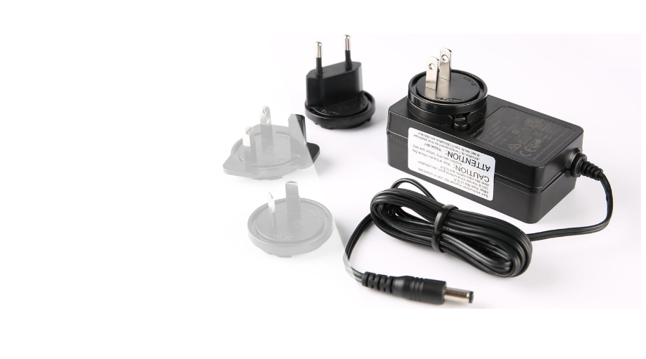
Interchangeable Type
Max.90W
Input: 100-240VAC, 50/60HZ
Output: 5-36VDC
Current: 100-6000mA
Power: 3W-90W
Color: White, Black or OEM
Certificate: IEC62368/61558/61347/60601

Slide 11
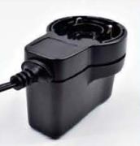
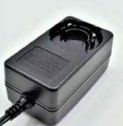
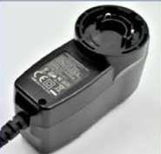
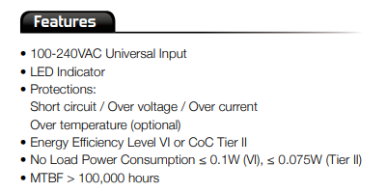
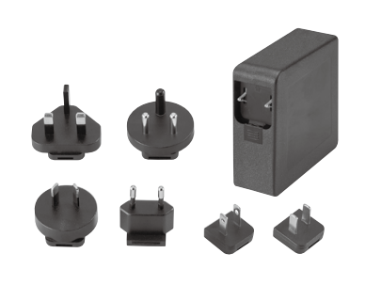
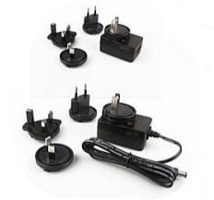
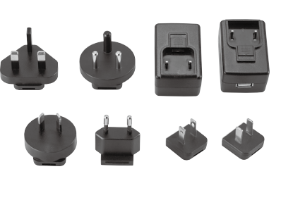
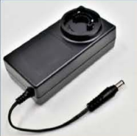
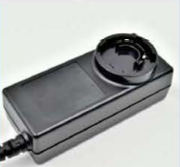
Interchangeable Types
6W-90W

Slide 12
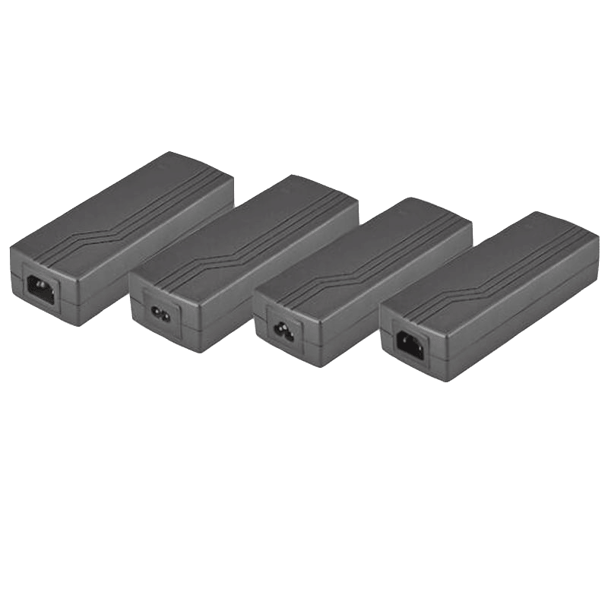

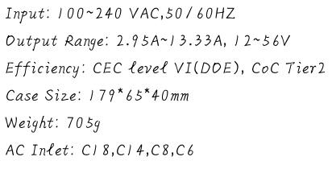
Desktop Power adapter 12W-350W

Slide 13
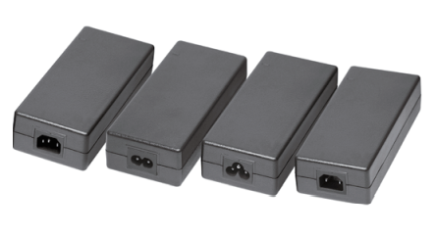
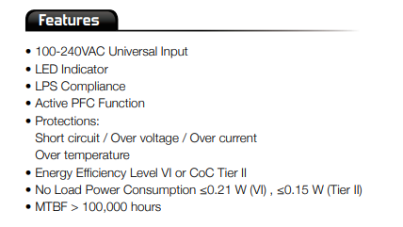
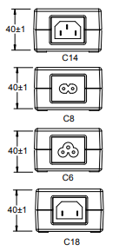
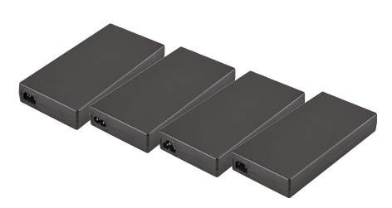
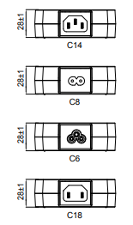
Desktop Power adapter 12W-350W

Slide 14
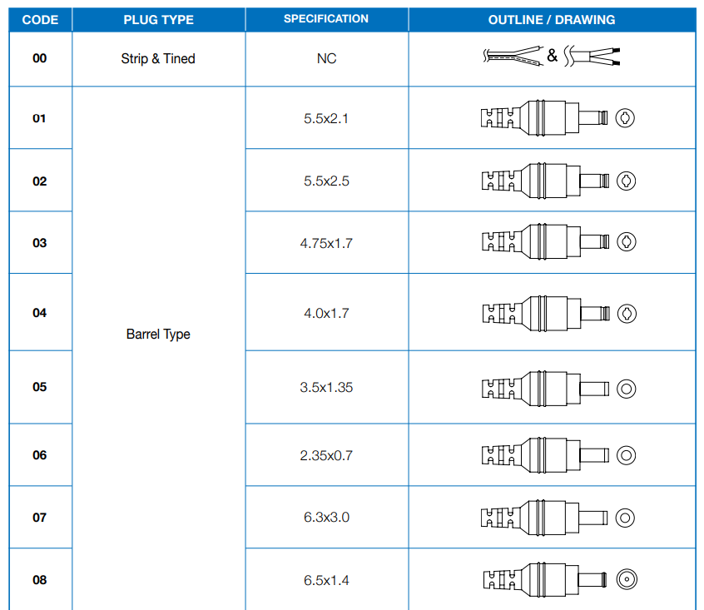
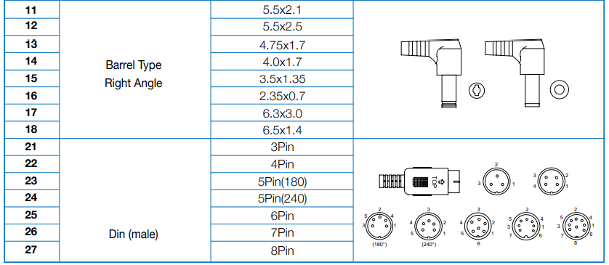
DC plugs for Power –PIN plugs

Slide 15
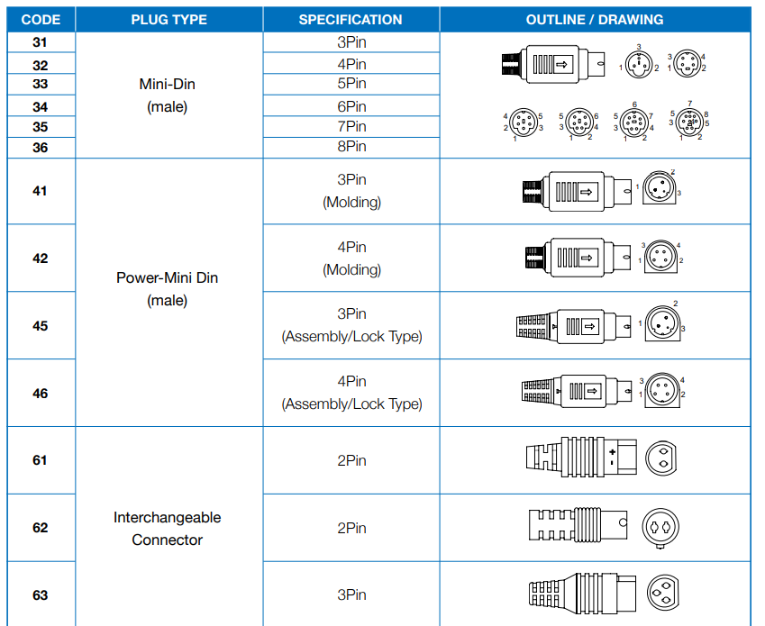
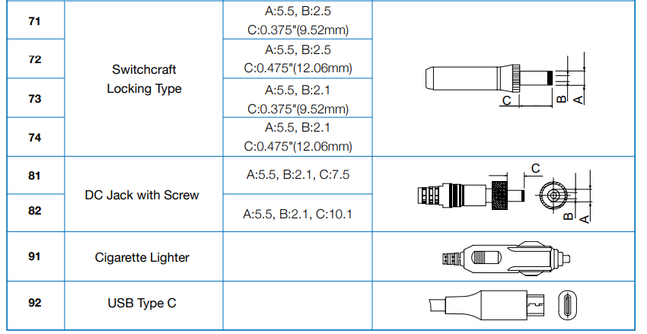
DC plugs for Power –Din plugs

Slide 16
02
Battery Charger / Open Frame/OEM/ODM
Technology that customers can enjoy

Slide 17
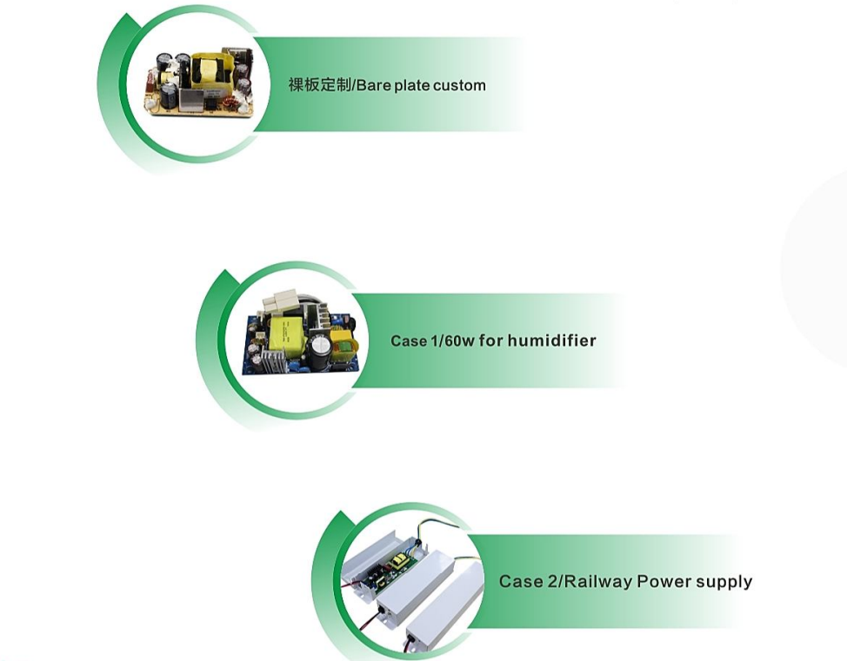
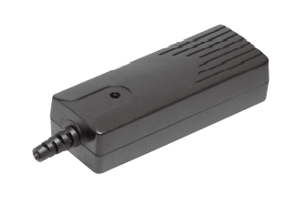
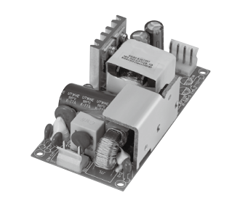
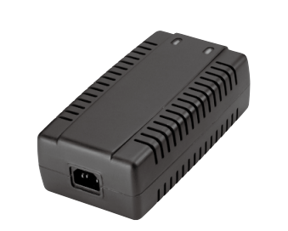

Slide 18
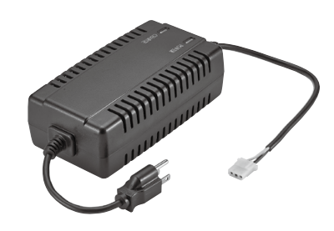



Battery Chargers

Slide 19





Liner Power Adapter

Slide 20






Open Frame

Slide 21
03
QC/PD Chargers

Slide 22

Product Series
10. 1C1A-PQ656x/65W
11. 2C1A -PQ655x/65W
12. 2C1A-PQ1005x/100W
13. 2C1A -PQ1401/140W
14. 3C1A -PQ657x/65W
15. 3C1A -PQ1002x/100W
16. 3C1A-PQ1004x/100W
17. 4C2A PQ1006D/100W
18. 1DC -A2401D/240W/
19. 3C1D-PT2401D/2402
1. 1C -PN351x/35W
2. 1C -PN651x/65W
3. 1C -PN1003x/100W
4. 1C- PN1402/140W
5. 2C-PT352x/35W
6. 2C-PT452x/45W
7. 2C-PT658x/65W
8. 2C-PT1401/140W
9. 1C1A-PQ352x/35W

Slide 23






Smart USB /TYPE C USB CHARGER

Slide 24



1C Type :35W, 65w, 100W,140W
PQ1003x/100W
Designing
Input : 100-240V
Ouput: PD3.0:5V3A/9V3A/12V2.5A/15V2.33A/20V1.75A
PPS: 3.3V-11V@3A;
Size: 40*40*29mm
Pin Shape: US/JP/TW/CN/EU/KC
Safety Cet: CCC,CB,CE,PSE
USB-C:
PD3.0:5V3A/9V3A/12V3A/15V3A/20V5A
Size: 72*40*28mm
Pin Shape: US/JP/TW/EU/KC+ Interchangeable
PN351x/35W
Ouput
USB-C1:PD3.1:5V3A/9V3A/12V3A/15V3A/20V5A/28V5A
Weight:
Size: 65*60*29
Shape: CN,PSE,BSMI,US,EU,KC,+
Interchangeable
Safety Cet:
Input : 100-240V
Ouput: PD3.0:5V3A/9V3A/12V3A/15V3A/20V3.25A
PPS: 3.3V-11V@5A;
Size: 40*50*29mm
Pin Shape: US/JP/TW/CN/EU/KC
Safety Cet: CCC,UL,FCC,CB,CE,PSE,KC,KCC,
PN651x/65W
PN1402x/140W/PFC
Designing

Slide 25



2C Type :35W, 45W,65W, 140W
Ouput USB-C1/C2: PD3.0:5V3A/9V3A/12V3A/15V3A/20V3.25A
PPS: 3.3V-11V@5A;
Size: 82*51*14.5mm
Pin Shape: US/JP/TW/CN
Safety Cet,
Special technology：PCBATransformer
Ouput:PD3.0:5V3A/9V3A/12V2.5A/15V2.33A/20V1.75A
PPS: 3.3V-11V@3A; C1+C2 5V4A
Size: 40*40*29mm
Pin Shape: US/JP/TW/CN/EU/KC
Safety Cet: CCC,CB,CE,PSE
PT352x/35W
PT658x/65W/2C
USB-C1/C2
Ouput:PD3.0:5V3A/9V3A/12V3A/15V3A/20V2,25A
PPS: 3.3V-11V@4.05A;
C1+C2 20WPD+20WPD
Size: 62*32*30mm
Pin Shape: US/JP/TW/CN/EU/KC
Safety Cet: CCC,CB,CE,PSE
USBC1:PD3.1:5V3A/9V3A/12V3A/15V3A/20V5A/28V5A
USBC2:PD3.0:5V3A/9V3A/12V3A/15V3A/20V5A
Size: 73*73*29
Pin :CN,PSE,BSMI,US,EU,KC,
+Interchangeable
Safety Cet,CCC,UL,FCC, PSE,KC,KCC,CB,CE
PT452x/45W
Designing
PT1401x/140W/PFC

Slide 26


1C1A Type :35W, 65W
PQ352x/35W/1C1A
PQ656x/65W/1C1A
Input : 100-240V
Ouput:
USB-A:QC/SCP:4.5V5A/5V4A/9V3A/12V2.5A/20V1.5A
USB-C:PD3.0:5V3A/9V3A/12V2.5A/15V2.33A/20V1.75A
PPS: 3.3V-11V@3A; C+A:5V4A
Size: 40*40*29mm
Pin Shape: US/JP/TW/CN/EU/KC
Safety Cet: CCC,CB,CE,PSE
Input : 100-240V
Output:
USB-C: PD3.0:5V3A/9V3A/12V3A/15V3A/20V3.25A
USB-A:QC3.0:5V3A,9V2A/12V1.5A
PPS:3.3V-11V@3A; C+A:45WPD+18WQC
Size: 41*66*29mm
Pin Shape: US/JP/TW/CN/EU/KC/UK
Safety Cet: CCC,ETL,FCC,CB,CE,PSE,KC,KCC,

Slide 27




2C1A Type :65W,100W,140W
C1/C2:PD3.0:5V3A/9V3A/12V2.5A/15V3A/20V3.25A
PPS: 3.3V-11V@5A;
USBA:QC/SCP/4.5V5A/5V4A/9V3A/12V2.5A/20V1.5A
C1+(C2+A):45WPD+(5V3A)
Size: 66*41*29
Pin Shape: US/JP/TW/CN/EU/KC/UK
Safety Cet: CCC,ETL,FCC,CB,CE,PSE,KC,KCC
USBC1/C2:PD3.0:5V3A/9V3A/12V3A/15V3A/20V5A
USBA:QC/SCP/4.5V5A/5V4A/9V3A/12V2.5A/20V1.5A
Size: 85*42*32
Pin Shape: Desktop/C8
Safety Cet,CCC, PSE,
Special technology：PCBATransformer
PQ1005D/100W/PFC
PQ655x/65W
PQ1401x/140W/PFC
USBC1/C2:
PD3.0:5V3A/9V3A/12V3A/15V3A/20V5A
USBA:5V4A/4.5V5A/9V3A/12V2.5A/20V1.5A
Size: 85*42*32mm
Pin Shape: CN,PSE,BSMI,US
Safety Cet,CCC, PSE,
Special technology：PCBA Transformer
USBC1 PD3.1:5V3A/9V3A/12V3A/15V3A/20V5A/28V5A
USBC2:PD3.0:5V3A/9V3A/12V3A/15V3A/20V5A
USBA:5V4A/4.5V5A/9V3A/12V2.5A/20V1.5A
Size: 73*73*29mm
Pin Shape: CN,PSE,BSMI,US,EU,KC,+Interchangeable
Safety Cet:CCC, UL,FCC,PSE,KC,KCC,CB,CE.
Special Technology：
The world's first PD3.1 3C accessory charger
PQ1005x/100W
PFC

Slide 28



3C1A Type :65w, 100W,100W
PQ657x/65W
PQ1002x/100W
USB-C1/C2:
PD3.0:5V3A/9V3A/12V3A/15V3A/20V5A
USB-C3:5V3A/9V2.2A/12V1.67A
USB-A:
QC/SCP/4.5V5A/5V4A/9V3A/12V2.5A/20V1.5A
Size: 75*60*29mm
Pin Shape: US/JP/TW/EU/KC +Interchangeable
Safety Cet,UL,FCC,CB,PSE,KC,KCC
C1/C2: PD3.0:5V3A/9V3A/12V3A/15V3A/20V3.25A
PPS: 3.3V-11V@5A;
C3: PD3.0:5V3A/9V2.22AA/12V1.67A
USB-A: QC/SCP/4.5V5A/5V4A/9V3A/12V2.5A/20V1.5A
Size: 50*50*29
Pin Shape: US/JP/TW/CN/EU/KC+Interchangeable
Safety Cet: CCC,ETL,FCC,CB,CE,PSE,KC,KCC
USB-C1/C2:
PD3.0:5V3A/9V3A/12V3A/15V3A/20V5A
USB-C3:5V3A/9V2.2A/12V1.67A
USB-A: QC/SCP/4.5V5A/5V4A/9V3A/12V2.5A/20V1.5A
Size: 75*60*29mm
Pin Shape: CN,UE,UK+Interchangeable
Safety Cet,CCC,CE,UKCA
PQ1004x/100W/PFC

Slide 29


PQ1006D/100W/4C1A/1W/PFC
4C2A PQ1006D/100W/PFC/Wireless charger
Input : 100-240V
Ouput:
USB-C1/C2:PD3.0:5V3A/9V3A/12V3A/15V3A/20V5A
USB-C3:5V3A/9V2.2A/12V1.67A
USB-A1/A2:4.5V5A/5V4A/9V3A/12V2.5A/20V1.5A
Wireless charger:15W
Weight:
Size: 120*83*30
Pin Shape:Desktop/C8
Safety Cet,CCC,CE,FCC

Slide 30

A2401D/240W/1D/PFC(Designing）
P2401D/240W/1D/PFC(Designing）
Input : 100-240V
Ouput：
1.A2401,DC:20V12A
2.P2401, USD3.1:5/9/12/15@3A/20/28/36/48V@5A
Weight: 115*63*30mm
Size: 65*60*29
Pin Shape: CN,PSE,BSMI,US
Safety Cet

Slide 31

THANK
YOU!
DESIGNED BY SUPPOWER

